Slide 1

TITLE OF IDEA
EYE CONTROLLED MOUSE
ExEEd- ACADEMIC SUCCESS
S.NO | Name | Roll No. | Branch & Section
1. | A VARDHAN | 21951A04P1 | ECE-A
2. | M VARDHAN | 21951A04P2 | ECE-A

Slide 2
Aim & Objective
The primary aim and objective of an eye mouse is to provide a means of computer input for individuals who are unable to use traditional input devices such as a keyboard or mouse due to physical disabilities, such as paralysis or motor impairment.
The eye mouse technology allows individuals to control the movement of the computer mouse using their eyes. The user's eye movements are tracked by a camera or other specialized equipment, and the software translates those movements into cursor movements on the computer screen. This technology provides an efficient and effective method of communication and control for people with disabilities, enabling them to perform tasks such as typing, navigating websites, and using software applications.
The ultimate goal of the eye mouse technology is to enhance the independence and quality of life for individuals with physical disabilities, empowering them to perform tasks that they might not otherwise be able to accomplish. Additionally, this technology aims to improve accessibility and inclusion for people with disabilities in various areas of society, including education, employment, and social interactions.

Slide 3
Problem Definition
The primary problem that the eye mouse technology aims to address is the inability of individuals with physical disabilities to use traditional computer input devices such as a keyboard or mouse. This can be due to a range of conditions, including paralysis, motor impairment, or other disabilities that affect their ability to use their hands and arms.
Without the ability to use a traditional input device, these individuals may face significant barriers to communication, education, employment, and social interaction. The eye mouse technology provides a solution to this problem by allowing individuals to control the movement of the computer mouse using their eyes, providing an efficient and effective means of communication and control.

Slide 4
Background of Idea (Who is it for?)
An eye mouse is a computer input device that allows individuals with physical disabilities to control the movement of the computer mouse using their eyes. The primary purpose of an eye mouse is to provide a means of computer input for individuals who are unable to use traditional input devices such as a keyboard or mouse due to physical disabilities, such as paralysis or motor impairment.
The eye mouse technology works by tracking the movements of the user's eyes using a camera or other specialized equipment. The software translates these eye movements into cursor movements on the computer screen, enabling the user to perform tasks such as typing, navigating websites, and using software applications.
The eye mouse technology is particularly useful for individuals with physical disabilities who may have limited mobility in their hands and arms, but who still require access to a computer for communication, education, employment, and social interaction. The technology provides an efficient and effective means of control and communication, enabling users to perform tasks that they might not otherwise be able to accomplish. Overall, the eye mouse is a valuable tool for improving accessibility and inclusion for people with disabilities in various areas of society.

Slide 5
Background of Idea (What will it do?)
An eye mouse enables individuals with physical disabilities to control the movement of the computer mouse using their eyes. Specifically, the eye mouse technology tracks the movements of the user's eyes using a camera or other specialized equipment, and the software translates those eye movements into cursor movements on the computer screen. This technology enables users to perform tasks such as typing, navigating websites, and using software applications, without the need for traditional input devices such as a keyboard or mouse.
The eye mouse technology has the potential to significantly enhance the independence and quality of life for individuals with physical disabilities, by providing a means of communication and control that is accessible and efficient. The eye mouse can enable individuals to perform tasks that they might not otherwise be able to accomplish, such as accessing educational materials, participating in online discussions, or working from home.
Overall, the eye mouse technology has the potential to improve accessibility and inclusion for people with disabilities in various areas of society, including education, employment, and social interactions. Additionally, ongoing research and development of the technology may lead to further advancements and improvements, expanding its potential uses and benefits for individuals with disabilities.

Slide 6
Background of Idea (Potential Markets)
The potential markets for eye mouse technology are primarily focused on individuals with physical disabilities who have difficulty using traditional input devices such as a keyboard or mouse. Some of the potential markets for eye mouse technology include:
Healthcare: Eye mouse technology can be used in healthcare settings to help patients with physical disabilities communicate with healthcare providers, access electronic health records, and participate in telemedicine consultations.
Education: Eye mouse technology can provide students with physical disabilities with access to educational materials and technology, enabling them to participate in online learning and educational activities.
Employment: Eye mouse technology can enable individuals with physical disabilities to work from home or in office settings, accessing the same technology and software as their non-disabled colleagues.
Entertainment: Eye mouse technology can enable individuals with physical disabilities to access and enjoy a range of entertainment options, including gaming, streaming services, and social media.

Slide 7
Background of Idea (Unique Features)
The eye mouse technology is a unique computer input device that has several distinctive features that set it apart from traditional input devices such as a keyboard or mouse. Some of the unique features of the eye mouse technology include:
Eye tracking: The eye mouse technology uses specialized cameras or other equipment to track the movements of the user's eyes, enabling precise control over the movement of the computer mouse.
Accessibility: Eye mouse technology is designed to be accessible for individuals with physical disabilities who may have difficulty using traditional input devices such as a keyboard or mouse. This technology provides an efficient and effective means of control and communication, enabling users to perform tasks that they might not otherwise be able to accomplish.
Speed and accuracy: Eye mouse technology can be faster and more accurate than traditional input devices, as users can move the cursor on the computer screen quickly and precisely using their eyes.
Customizable settings: Eye mouse technology often comes with customizable settings that allow users to adjust the sensitivity of the eye tracking technology to suit their needs and preferences.

Slide 8
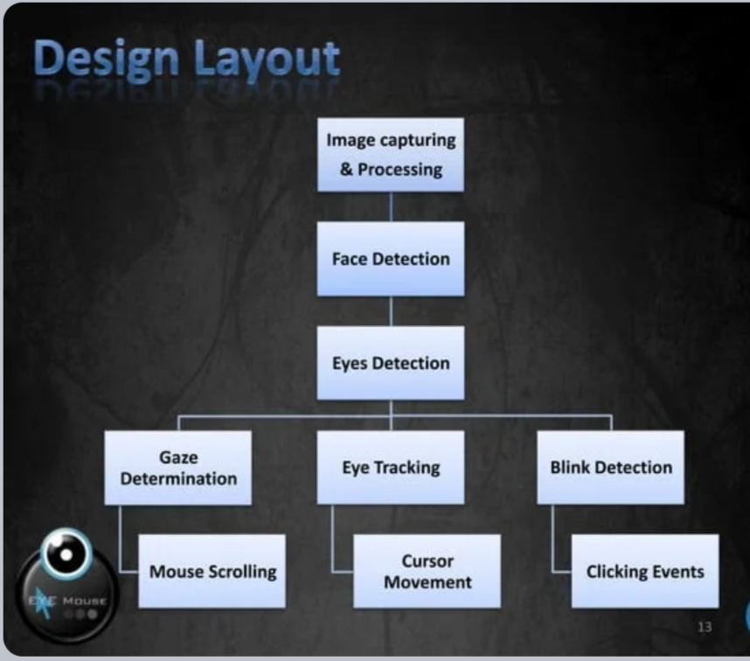


Slide 9
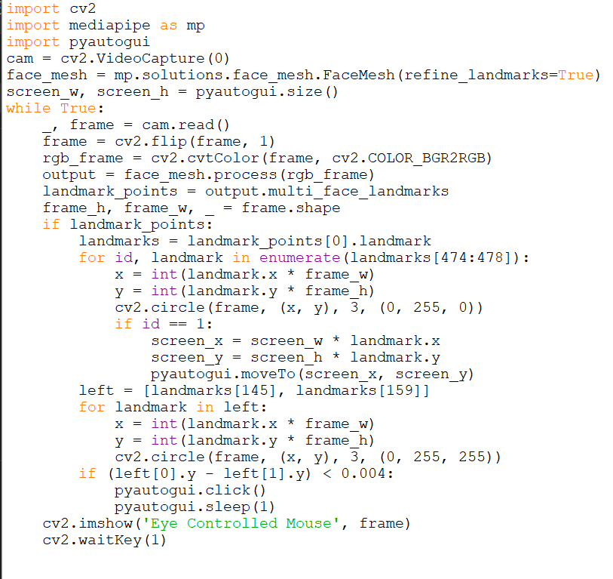
Design & Drawings of Prototype (Rough Sketches)

Slide 10

IMAGES RELATED TO PROTOTYPE:

Slide 11
Conclusion
In conclusion, eye mouse technology is a promising innovation that enables individuals with physical disabilities to control their computer using only their eyes. Eye mouse technology uses specialized cameras or other equipment to track eye movements and translates those movements into cursor movements on the computer screen. This technology can significantly improve accessibility and inclusion for individuals with physical disabilities in various areas of society, including healthcare, education, employment, entertainment, and assistive technology.
Eye mouse technology has several unique features that set it apart from traditional input devices, including eye tracking, accessibility, speed and accuracy, customizable settings, and hands-free operation. However, developing a fully functional eye mouse requires a complex and sophisticated implementation that involves eye tracking, machine learning, and user interface design. Ongoing research and development of eye mouse technology have the potential to further enhance its capabilities, expanding its potential uses and benefits for individuals with physical disabilities.

Slide 12
References
Here are some references related to eye mouse technology:
“Eye-controlled human-computer interfaces." by J. F. Juang et al. in Proceedings of the IEEE (2013).
"An eye tracking-based mouse emulator." by P. Han et al. in Journal of Rehabilitation Research and Development (2011).
“

Slide 13


